Slide 1


OPERATING SYSTEM
INSY 8223
Faculty of IT, GROUP D&F
Mr Uzayisenga Emmanuel / Dr Eric NIZEYIMANA / Mr Archimede IRAKOZE/ N. Gilbert
eric.nizeyimana@auca.ac.rw| +250 783 308 544, 0783219523(Gilbert)

Slide 2
Lesson 3. Process Management

Slide 3
Learning Objectives
Describe process lifecycle
Explain Process Control Block (PCB)
Understand context switching
Explore CPU scheduling techniques
Apply scheduling algorithms

Slide 4
What is a Process?
A process is basically a program in execution. The execution of a process must progress in a sequential fashion.
A process is defined as an entity which represents the basic unit of work to be implemented in the system.
To put it in simple terms, we write our computer programs in a text file and when we execute this program, it becomes a process which performs all the tasks mentioned in the program.
When a program is loaded into the memory and it becomes a process, it can be divided into four sections ─ stack, heap, text and data.

Slide 5

Types of Processes
User vs System processes
Batch vs Interactive processes
CPU-bound vs I/O-bound processes

Slide 6

Importance of Process Management
Efficient CPU utilization
Fair resource allocation
Enables multiprogramming
Provides isolation and security

Slide 7
Sections of a Process Description
S.N. | Component & Description
1 | Stack The process Stack contains the temporary data such as method/function parameters, return address and local variables.
2 | Heap This is dynamically allocated memory to a process during its run time.
3 | Text This includes the current activity represented by the value of Program Counter and the contents of the processor's registers.
4 | Data This section contains the global and static variables.

Slide 8
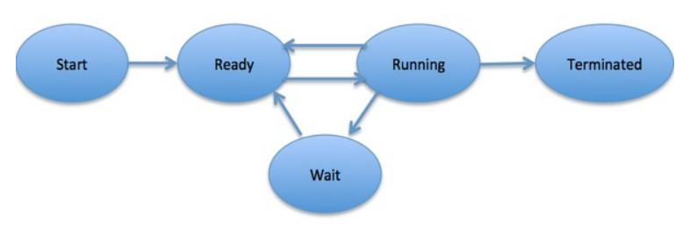
PROCESS LIFE CYCLE
When a process executes, it passes through different states. These stages may differ in different operating systems, and the names of these states are also not standardized.
In general, a process can have one of the following five states at a time.

Slide 9
Process States Description
S.N. | State & Description
1 | Start This is the initial state when a process is first started/created.
2 | Ready The process is waiting to be assigned to a processor. Ready processes are waiting to have the processor allocated to them by the operating system so that they can run. Process may come into this state after Start state or while running it by but interrupted by the scheduler to assign CPU to some other process.
3 | Running Once the process has been assigned to a processor by the OS scheduler, the process state is set to running and the processor executes its instructions.
4 | Waiting Process moves into the waiting state if it needs to wait for a resource, such as waiting for user input, or waiting for a file to become available.
5 | Terminated or Exit Once the process finishes its execution, or it is terminated by the operating system, it is moved to the terminated state where it waits to be removed from main memory.

Slide 10
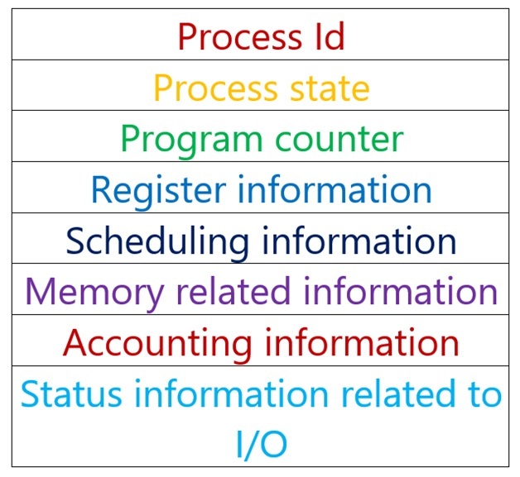
PROCESS CONTROL BLOCK (PCB)
A Process Control Block is a data structure maintained by the Operating System for every process. The PCB is identified by an integer process ID (PID). A PCB keeps all the information needed to keep track of a process.
The PCB is maintained for each process throughout its lifetime, and is deleted once the process terminates.

Slide 11
Information kept PCB
S.N. | Information & Description
1 | Process State The current state of the process i.e., whether it is ready, running, waiting, or whatever.
2 | Process privileges This is required to allow/disallow access to system resources.
3 | Process ID Unique identification for each of the process in the operating system.
4 | Pointer A pointer to parent process.
5 | Program Counter Program Counter is a pointer to the address of the next instruction to be executed for this process.

Slide 12
Information kept PCB (Cont..)
S.N. | Information & Description
6 | CPU registers Various CPU registers where process need to be stored for execution for running state.
7 | CPU Scheduling Information Process priority and other scheduling information which is required to schedule the process.
8 | Memory management information This includes the information of page table, memory limits, Segment table depending on memory used by the operating system.
9 | Accounting information This includes the amount of CPU used for process execution, time limits, execution ID etc.
10 | IO status information This includes a list of I/O devices allocated to the process.

Slide 13

Process scheduling
The process scheduling is the activity of the process manager that handles the removal of the running process from the CPU and the selection of another process on the basis of a particular strategy.
Process scheduling is an essential part of a Multiprogramming operating systems. Such operating systems allow more than one process to be loaded into the executable memory at a time and the loaded process shares the CPU using time multiplexing.

Slide 14
Categories of Scheduling
There are two categories of scheduling:
Non-preemptive: Here the resource can’t be taken from a process until the process completes execution. The switching of resources occurs when the running process terminates or moves to a waiting state.
Preemptive: Here the OS allocates the resources to a process for a fixed amount of time. During resource allocation, the process switches from running state to ready state or from waiting state to ready state. This switching occurs as the CPU may give priority to other processes and replace the process with higher priority with the running process.

Slide 15

Categories of Schedulling
Non-preemptive: Here the resource can’t be taken from a process until the process completes execution. The switching of resources occurs when the running process terminates or moves to a waiting state.
Preemptive: Here the OS allocates the resources to a process for a fixed amount of time. During resource allocation, the process switches from running state to ready state or from waiting state to ready state. This switching occurs as the CPU may give priority to other processes and replace the process with higher priority with the running process.

Slide 16
PROCESS SCHEDULING QUEUES
The OS maintains all Process Control Blocks (PCBs) in Process Scheduling Queues. The OS maintains a separate queue for each of the process states and PCBs of all processes in the same execution state are placed in the same queue. When the state of a process is changed, its PCB is unlinked from its current queue and moved to its new state queue.
The Operating System maintains the following important process scheduling queues :
Job queue
Ready queue
Device queues

Slide 17
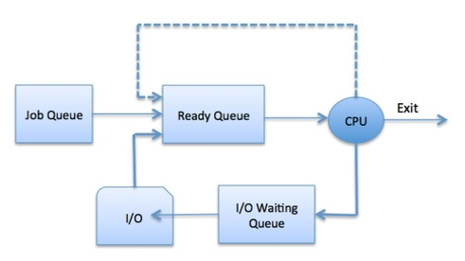
Queues description
Job queue − This queue keeps all the processes in the system.
Ready queue − This queue keeps a set of all processes residing in main memory, ready and waiting to execute. A new process is always put in this queue.
Device queues − The processes which are blocked due to unavailability of an I/O device constitute this queue.

Slide 18
Cont’
The OS can use different policies to manage each queue (FIFO, Round Robin, Priority, etc.).
The OS scheduler determines how to move processes between the ready and run queues which can only have one entry per processor core on the system; in the above diagram, it has been merged with the CPU.

Slide 19
Two-State Process Model
S.N. | State & Description
1 | Running When a new process is created, it enters into the system as in the running state.
2 | Not Running Processes that are not running are kept in queue, waiting for their turn to execute. Each entry in the queue is a pointer to a particular process. Queue is implemented by using linked list. Use of dispatcher is as follows. When a process is interrupted, that process is transferred in the waiting queue. If the process has completed or aborted, the process is discarded. In either case, the dispatcher then selects a process from the queue to execute.

Slide 20
SCHEDULERS
Schedulers are special system software which handle process scheduling in various ways. Their main task is to select the jobs to be submitted into the system and to decide which process to run. Schedulers are of three types:
Long-Term Scheduler
Short-Term Scheduler
Medium-Term Scheduler

Slide 21
Long Term Scheduler
It is also called a job scheduler. A long-term scheduler determines which programs are admitted to the system for processing. It selects processes from the queue and loads them into memory for execution. Process loads into the memory for CPU scheduling.
The primary objective of the job scheduler is to provide a balanced mix of jobs, such as I/O bound and processor bound. It also controls the degree of multiprogramming. If the degree of multiprogramming is stable, then the average rate of process creation must be equal to the average departure rate of processes leaving the system.
On some systems, the long-term scheduler may not be available or minimal. Time-sharing operating systems have no long term scheduler. When a process changes the state from new to ready, then there is use of long-term scheduler.

Slide 22
Short Term Scheduler
It is also called as CPU scheduler. Its main objective is to increase system performance in accordance with the chosen set of criteria. It is the change of ready sate to running state of the process. CPU scheduler selects a process among the processes that are ready to execute and allocates CPU to one of them.
Short-term schedulers, also known as dispatchers, make the decision of which process to execute next. Short-term schedulers are faster than long-term schedulers.

Slide 23
Medium Term Scheduler
Medium-term scheduling is a part of swapping. It removes the processes from the memory. It reduces the degree of multiprogramming. The medium-term scheduler is in-charge of handling the swapped out-processes.
A running process may become suspended if it makes an I/O request. A suspended processes cannot make any progress towards completion. In this condition, to remove the process from memory and make space for other processes, the suspended process is moved to the secondary storage. This process is called swapping, and the process is said to be swapped out or rolled out. Swapping may be necessary to improve the process mix.

Slide 24
Comparison among Scheduler
S.N. | Long-Term Scheduler | Short-Term Scheduler | Medium-Term Scheduler
1 | It is a job scheduler | It is a CPU scheduler | It is a process swapping scheduler.
2 | Speed is lesser than short term scheduler | Speed is fastest among other two | Speed is in between both short and long term scheduler.
3 | It controls the degree of multiprogramming | It provides lesser control over degree of multiprogramming | It reduces the degree of multiprogramming.
4 | It is almost absent or minimal in time sharing system | It is also minimal in time sharing system | It is a part of Time sharing systems.
5 | It selects processes from pool and loads them into memory for execution | It selects those processes which are ready to execute | It can re-introduce the process into memory and execution can be continued.

Slide 25
CONTEXT SWITCHING
A context switching is the mechanism to store and restore the state or context of a CPU in Process Control block so that a process execution can be resumed from the same point at a later time.
Using this technique, a context switcher enables multiple processes to share a single CPU. Context switching is an essential part of a multitasking operating system features.
When the scheduler switches the CPU from executing one process to execute another, the state from the current running process is stored into the process control block.
After this, the state for the process to run next is loaded from its own PCB and used to set the PC, registers, etc. At that point, the second process can start executing.

Slide 26
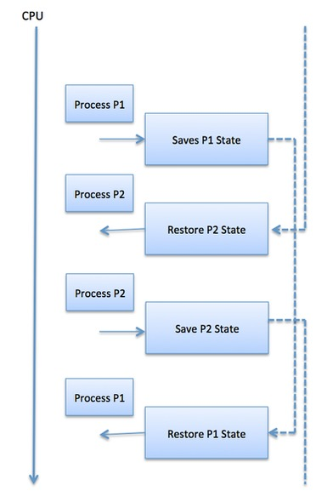
Context Switching (Cont’)
Context switches are computationally intensive since register and memory state must be saved and restored. To avoid the amount of context switching time, some hardware systems employ two or more sets of processor registers. When the process is switched, the following information is stored for later use.
Program Counter
Scheduling information
Base and limit register value
Currently used register
Changed State
I/O State information
Accounting information

Slide 27
Context Switching
Saving and restoring process state
Allows CPU to switch between processes

Slide 28
Steps in Context Switch
Save state of current process
1
Update PCB
2
Load state of next process
3
Resume execution
4

Slide 29

Context Switching Overhead
Takes CPU time (no productive work)
Frequent switches reduce efficiency

Slide 30

PCB & Context Switching
PCB holds process state
Context switch updates PCB
OS uses PCB to resume process

Slide 31
OPERATING SYSTEM SCHEDULING ALGORITHMS
A Process Scheduler schedules different processes to be assigned to the CPU based on particular scheduling algorithms. There are five popular process scheduling algorithms which we are going to discuss:
First-Come, First-Served (FCFS) Scheduling
Shortest-Job-Next (SJN) Scheduling
Shortest Remaining Time
Priority Scheduling
Round Robin(RR) Scheduling
Multiple-Level Queues Scheduling

Slide 32
Cont’
These algorithms are either non-preemptive or preemptive. Non-preemptive algorithms are designed so that once a process enters the running state, it cannot be preempted until it completes its allotted time, whereas the preemptive scheduling is based on priority where a scheduler may preempt a low priority running process anytime when a high priority process enters into a ready state.

Slide 33
Scheduling algorithm optimizing
When designing or evaluating a scheduling algorithm, several key criteria must be considered to ensure optimal performance and efficiency.
These criteria help determine how well the algorithm allocates CPU resources to various processes, aiming to balance system responsiveness, fairness, and throughput.
By optimizing factors such as CPU utilization, turnaround time, and waiting time, scheduling algorithms can improve overall system performance, minimize delays, and enhance the user experience.

Slide 34
The most important criteria for optimizing a scheduling algorithm
Criteria | Description
1. CPU Utilization | Maximizes the percentage of time the CPU is actively executing processes, reducing idle time.
2. Throughput | The number of processes completed per unit of time; higher throughput indicates better system efficiency.
3. Turnaround Time | Total time taken from the submission of a process to its completion; shorter times improve responsiveness.
4. Waiting Time | Time a process spends waiting in the ready queue; lower waiting times improve efficiency.
5. Response Time | Time from process submission to its first execution; reducing this improves interactivity and experience.
6. Fairness | Ensures that all processes receive a fair share of CPU time, preventing starvation or monopolization.

Slide 35

1. First Come First Serve (FCFS)
Jobs are executed on first come, first serve basis.
It is a non-preemptive algorithm.
Easy to understand and implement.
Its implementation is based on FIFO queue.
Poor in performance as average wait time is high.

Slide 36
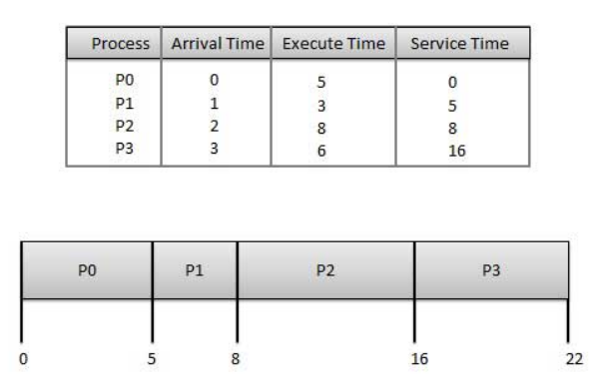
Calculate Average Wait time
Wait time of each process is as follows:
Process | Wait Time : Service Time - Arrival Time
P0 | 0 - 0 = 0
P1 | 5 - 1 = 4
P2 | 8 - 2 = 6
P3 | 16 - 3 = 13
Average Wait Time: (0+4+6+13) / 4 = 5.75

Slide 37

2. Shortest Job Next (SJN)
This is also known as shortest job first, or SJF
This is a non-preemptive, pre-emptive scheduling algorithm.
Best approach to minimize waiting time.
Easy to implement in Batch systems where required CPU time is known in advance.
Impossible to implement in interactive systems where required CPU time is not known.
The processer should know in advance how much time process will take.

Slide 38
Calculate Average Wait time
Process | Arrival Time | Execution Time | Service Time
P0 | 0 | 5 | 0
P1 | 1 | 3 | 5
P2 | 2 | 8 | 14
P3 | 3 | 6 | 8
Process Waiting Time
P0 0 - 0 = 0
P1 5 - 1 = 4
P2 14 - 2 = 12
P3 8 - 3 = 5
Average Wait Time:
(0 + 4 + 12 + 5)/4 = 21 / 4 = 5.25
P0 | P1 | P3 | P2
0 5 8 14 22

Slide 39
Shortest Remaining Time
Shortest remaining time (SRT) is the preemptive version of the SJN algorithm.
The processor is allocated to the job closest to completion but it can be preempted by a newer ready job with shorter time to completion.
Impossible to implement in interactive systems where required CPU time is not known.
It is often used in batch environments where short jobs need to give preference.

Slide 40
Calculate AWT using Shortest Remaining Time
Process | Arrival Time | Execution Time | Completion Time
P0 | 0 | 5 | 8
P1 | 1 | 3 | 4
P2 | 2 | 8 | 22
P3 | 3 | 6 | 14
Turnaround Time (TAT)= CT−Arrival Time
P0: 8-0=8
P1: 4-1=3
P2: 22-2=20
P3: 14-3=11
Waiting Time (WT) = TAT−Execution Time
P0: 8-5=3
P1=3-3=0
P2=20-8=12
P3=11-6=5
AWT=(3+0+12+5)/4 =20/4 =5.0
P0 | P1 | P0 | P3 | P2
0 | 1 | 4 | 8 | 14 22

Slide 41

3. Priority Based Scheduling
Priority scheduling is both preemptive and non-preemptive algorithm and one of the most common scheduling algorithms in batch systems.
Each process is assigned a priority. Process with highest priority is to be executed first and so on.
Processes with same priority are executed on first come first served basis.
Priority can be decided based on memory requirements, time requirements or any other resource requirement.

Slide 42
Calculate Average wait time
Process | Arrival Time | Execution Time | Priority | Service Time
P0 | 0 | 5 | 1 | 0
P1 | 1 | 3 | 2 | 11
P2 | 2 | 8 | 1 | 14
P3 | 3 | 6 | 3 | 5
Process Waiting Time
P0 0 - 0 = 0
P1 11 - 1 = 10
P2 14 - 2 = 12
P3 5 - 3 = 2
Average Wait Time:
(0 + 10 + 12 + 2)/4 = 24 / 4 = 6
P0 | P3 | P1 | P2
0 5 11 14 22

Slide 43

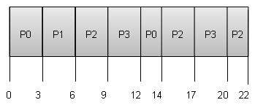
4. Round Robin Scheduling
Round Robin is the preemptive process scheduling algorithm.
Each process is provided a fix time to execute, it is called a quantum.
Once a process is executed for a given time period, it is preempted and other process executes for a given time period.
Context switching is used to save states of preempted processes.
Quantum=3

Slide 44
Calculate
Quantum=3
Process Wait Time : Service Time - Arrival Time
P0 (0 - 0) + (12 - 3) = 9
P1 (3 - 1) = 2
P2 (6 - 2) + (14 - 9) + (20 - 17) = 12
P3 (9 - 3) + (17 - 12) = 11
Average Wait Time: (9+2+12+11) / 4 = 8.5

Slide 45
5. Multiple-Level Queues Schedulling
Multiple-level queues are not an independent scheduling algorithm. They make use of other existing algorithms to group and schedule jobs with common characteristics.
Multiple queues are maintained for processes with common characteristics.
Each queue can have its own scheduling algorithms.
Priorities are assigned to each queue.
For example, CPU-bound jobs can be scheduled in one queue and all I/O-bound jobs in another queue. The Process Scheduler then alternately selects jobs from each queue and assigns them to the CPU based on the algorithm assigned to the queue.

Slide 46
Lab work and Assignment in C++
4 lab works
1 to be submitted as an assignment

Slide 47
Lesson 4. Inter-Process Communication (IPC)

Slide 48

Thank you
For I know the thoughts that I think toward you, saith the LORD, thoughts of peace, and not of evil, to give you an expected end. Jeremy 29:11

